Slide 1
Introduction to Web Designing (HTML)
Nisar Ahmed Siddiqui
Lecturer Computer Science
Sukkur IBA University

Slide 2

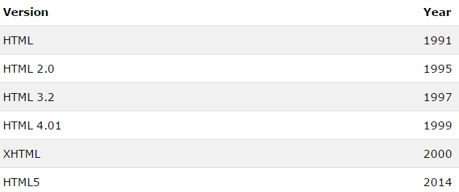

Slide 3
Whats new in HTML5
Semantics: allowing you to describe more precisely what your content is.
Connectivity: allowing you to communicate with the server in new and innovative ways.
Offline and storage: allowing webpages to store data on the client-side locally and operate offline more efficiently.
Multimedia: making video and audio first-class citizens in the Open Web.
2D/3D graphics and effects: allowing a much more diverse range of presentation options.
Performance and integration: providing greater speed optimization and better usage of computer hardware.
Device access: allowing for the usage of various input and output devices.
Styling: letting authors write more sophisticated themes.
Notes:
New in HTML5
Sections and outlines in HTML5
A look at the new outlining and sectioning elements in HTML5: <section>, <article>, <nav>, <header>, <footer> and <aside>.
Using HTML5 audio and video
The <audio> and <video> elements embed and allow the manipulation of new multimedia content.
Forms improvements
A look at the constraint validation API, several new attributes, new values for the <input> attribute type and the new <output> element.
New semantic elements
Beside sections, media and forms elements, there are numerous new elements, like <mark>, <figure>, <figcaption>, <data>, <time>, <output>, <progress>, or <meter> and <main>, increasing the number of valid HTML5 elements.
Improvement in <iframe>
Using the sandbox and srcdoc attributes, authors can now be precise about the level of security and the wished rendering of an <iframe> element.
New form control attributes like a placeholder, autofocus, email, URL, required, pattern, number, range, color, tel, search, date, date-time, file, required as an attribute. autofocus , autocomplete=”off”, autocomplete=”on”,data list ,min and max ,enable, read-only , disable ,size.
New HTML5 API’s (Application Programming Interfaces)
The most interesting new API’s are:
HTML Geolocation: HTML Geolocation is used to locate a user’s position. The HTML Geolocation API is used to get the geographical position of a user.
HTML Drag and Drop: Drag and drop is a very common feature. It is when you “grab” an object and drag it to a different location.
HTML Local Storage: With local storage, web applications can store data locally within the user’s browser.
HTML Application Cache: Application caching mechanism lets web-based applications run offline.With application cache, it is easy to make an offline version of a web application, by creating a cache manifest file. Developers can use the Application Cache (AppCache) interface to specify resources that the browser should cache and make available to offline users. Applications that are cached load and work correctly even if users click the refresh button when they are offline.
HTML Web Workers: Web Workers provide a simple means for web content to run scripts in background threads.
HTML SSE: Server-Sent Events allow a web page to get updates from a server.
What technologies are part of HTML5?
Here is a list of the technologies that are part of HTML5: (some of these are explained above)
Canvas2D CSS3 Drag and Drop File API Geolocation Microdata Offline Applications Server Sent Events (SSE) SVG Web Intents Web Messaging Web Storage Web Sockets Web Workers

Slide 4

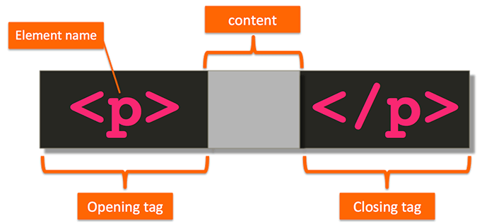

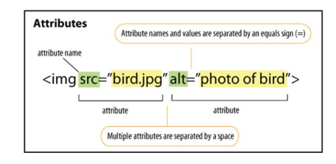

Slide 5

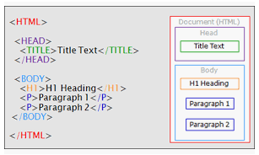

Slide 6
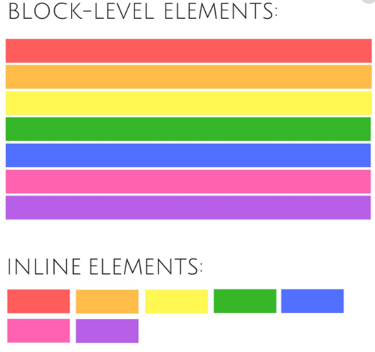
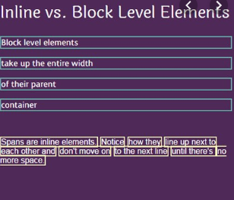
HTML Element Types

Slide 7
HTML ELEMENTS
<blockquote cite="uri"> </blockquote>
Notes:
The blockquote element is a mechanism for marking up a block of text quoted from a person or another document or source. It may be just a few lines, or it may contain
several paragraphs

Slide 8
HTML ELEMENTS
<br/>
Notes:
The br element’s purpose is very simple: it creates a line break within a block of
text, leaving no padding or margins between the two blocks of text created by the
line break.

Slide 9
HTML ELEMENTS
<div align=" { left | center | right | justify } "></div>
Notes:
The div is a generic block-level element. It doesn’t convey any meaning about its contents like paragraph. div element can be used to group almost any elements together. Indeed, it can contain almost any other element, unlike p, which can only contain inline elements.

Slide 10
HTML ELEMENTS
<h1></h1> to <h6></h6>
Notes:
This element may contain any text content, but it can’t include any block-level elements: only inline or phrase elements can be included

Slide 11
HTML ELEMENTS
<hr/>
Notes:
The hr element creates in the document a highly visible break that renders as a slim horizontal line running the width of the area to which it’s applied. The hr element can be used to create a break in a document at a point where there may be a change of thought or meaning, but where it may not necessarily be appropriate to introduce a subheading.

Slide 12
HTML ELEMENTS
<base href=“uri”></base>
Notes:
The base element, which is contained in the head of the document, provides a method for defining the base URL for all links and form submissions on a page.
Half link that is the common path for all the links in a page would be in the base tag and other would be in the href attribute of anchor tag itself.
The issue you're encountering with the `<base>` tag is likely because you're using a local file path (`D:\Web Engr\Portfolio`) in the `href` attribute. The `<base>` tag is designed to work with **URL-based paths**, not local file system paths. Browsers generally have restrictions on accessing files from local directories due to security reasons.
### Solution:
1. **Use a relative or absolute URL path** instead of a local file path. For local development, you can use relative paths like `./images/` if your image files are in a subdirectory of your project.
### Corrected Example:
```html
<head>
<base href="./Portfolio/" />
</head>
<body>
<img src="linkedin.png" alt="sfdsfd" />
</body>
```
Here:
- The `base href="./Portfolio/"` sets the base URL relative to the location of the HTML file.
- Ensure the image `linkedin.png` is located in the `Portfolio` folder relative to your HTML file.
Alternatively, for web projects hosted on a server, you would set the base URL to something like `https://yourwebsite.com/` and adjust paths accordingly.
If you're testing locally, try using a simple web server (like using VS Code's Live Server or Python's `http.server` module) to avoid file access issues caused by local paths.

Slide 13
HTML ELEMENTS
<link href="uri“ rel="relationship" type="content type"/>
Notes:
To define the location of stylesheet it is href=“uri”
To define relationship it is rel=“stylesheet” or it can be rel=“alternate stylesheet” (in this case if first is not available then apply this one)
To define MIME type it is type=“text/css”
To define media it is media=“screen and so on”

Slide 14
HTML ELEMENTS
<meta http-equiv=“content-type” content=“text/html” charset=“UTF-8” />
Notes:
*
The meta element provides information about the following document content; that information may be used by the user agent (that is, the browser) to decide how to render content, or it may be meta information that’s provided for indexing purposes—for example, to provide keywords that relate to the document for use by search engines or some other form of web service.
<meta http-equiv="Content-Type" content="text/html; charset=UTF-8">
<!— sets character encoding —>
http://www.standardista.com/html5/http-equiv-the-meta-attribute-explained/

Slide 15
HTML ELEMENTS
<meta http-equiv=“refresh” content=“5” />
Notes:
*
The meta element provides information about the following document content; that information may be used by the user agent (that is, the browser) to decide how to render content, or it may be meta information that’s provided for indexing purposes—for example, to provide keywords that relate to the document for use by search engines or some other form of web service.
<meta http-equiv="Refresh" content="5">
<!— refreshes the page content every five seconds —>
http://www.standardista.com/html5/http-equiv-the-meta-attribute-explained/

Slide 16
HTML ELEMENTS
<meta name=“robots” content=“noindex, follow” />
Notes:
*
The meta element provides information about the following document content; that information may be used by the user agent (that is, the browser) to decide how to render content, or it may be meta information that’s provided for indexing purposes—for example, to provide keywords that relate to the document for use by search engines or some other form of web service.
<meta name="robots" content="noindex,follow">
<!— instructs search engines not to index this page, but to follow links from the page —>
The "robots" meta tag is used to tell robots (that is, search engine crawlers/spiders) not to index the content of a page, nor to scan it for links to follow.
http://www.standardista.com/html5/http-equiv-the-meta-attribute-explained/

Slide 17
HTML ELEMENTS
<meta name="description" content="A brief summary/description “ />
Notes:
The `<meta>` tag in HTML provides metadata about the HTML document, such as character set, page description, keywords, author, and viewport settings. It is placed within the `<head>` section and helps with search engine optimization (SEO) and proper rendering on different devices.

Slide 18
HTML ELEMENTS
<meta name="keywords" content="reference, SitePoint, HTML, XHTML, standards“ />
Notes:
*
The meta element provides information about the following document content; that information may be used by the user agent (that is, the browser) to decide how to render content, or it may be meta information that’s provided for indexing purposes—for example, to provide keywords that relate to the document for use by search engines or some other form of web service.
<meta name="keywords" content="reference, SitePoint,
HTML, XHTML, standards">
<!—comma-separated list of keywords that apply to the page —>
http://www.standardista.com/html5/http-equiv-the-meta-attribute-explained/

Slide 19
HTML ELEMENTS
<script type="text/javascript“ src=“uri” language=“javascript 1.2”> </script>
Notes:
defer is also an attribute to defer the invocation of alert box up to the loading time of a page and it would be defer=“defer”

Slide 20
HTML ELEMENTS
<noscript>html elements</noscript>
Notes:
The noscript element has but one purpose: to provide content for people accessing the web page with a browser that either doesn’t support client-side scripting, or
that has had its script support disabled by the user, perhaps for security reasons.
The `<noscript>` tag in HTML is used to provide alternative content for users who have disabled JavaScript in their browsers or for browsers that do not support JavaScript. It allows developers to present fallback content when scripts cannot be executed.
### Real-Life Example:
Suppose you have a web application that relies heavily on JavaScript for functionality, such as a dynamic form that uses AJAX to submit data without refreshing the page. You can use the `<noscript>` tag to inform users that they need to enable JavaScript for the best experience.
```html
<!DOCTYPE html>
<html lang="en">
<head>
<meta charset="UTF-8">
<meta name="viewport" content="width=device-width, initial-scale=1.0">
<title>JavaScript Required Example</title>
<script>
// JavaScript code that runs when enabled
document.addEventListener("DOMContentLoaded", function() {
document.getElementById("dynamicContent").innerText = "JavaScript is enabled!";
});
</script>
</head>
<body>
<h1>Welcome to Our Website</h1>
<div id="dynamicContent"></div>
<noscript>
<div style="color: red;">
<p><strong>Important:</strong> This website requires JavaScript to function properly. Please enable JavaScript in your browser settings.</p>
</div>
</noscript>
</body>
</html>
```
### Explanation:
- If JavaScript is enabled, the message "JavaScript is enabled!" will be displayed.
- If JavaScript is disabled, the `<noscript>` content will be shown, informing the user that JavaScript is required for proper functionality. This helps ensure that users understand why certain features may not work without JavaScript.

Slide 21
HTML ELEMENTS
<style media= "screen" type= "text/css"></style>
<style media= "print" type= "text/css"></style>
Notes:
To define type it is type=“text/css”
To define media it is media=“all | aural | braille | embossed | handheld | print | projection | screen | tty | tv }”

Slide 22
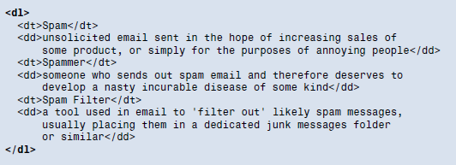
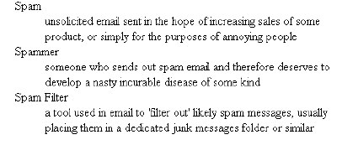
HTML ELEMENTS
Notes:
The dl = definition list
The dt = definition term
The dd = definition description
compact="compact“ attribute of definition list instruct the browser to render the definition list into a smaller text block by reducing the spacing between lines and/or reducing the default indentation.

Slide 23
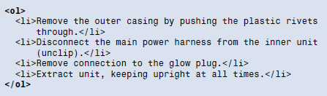

HTML ELEMENTS
Notes:
type=" { a | A | i | I | 1 } “ such as: a=small alphabet, A=capital, i=small roman numbers, I=capital roman numbers, 1 = numbers
start="number“ , it starts list from the given number

Slide 24
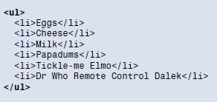
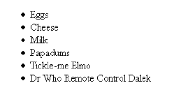
HTML ELEMENTS
Notes:
type=" { circle | disc | square } "

Slide 25
HTML ELEMENTS
<a href=“URL” target=“_blank/_self/_parent/_top”></a>
<a href=“#para” ></a> <p id=“para”></p>
Notes:
Default colors: unvisisted=blue, visisted=purple and active=red
Use link, alink, and vlink attributes of body tag

Slide 26
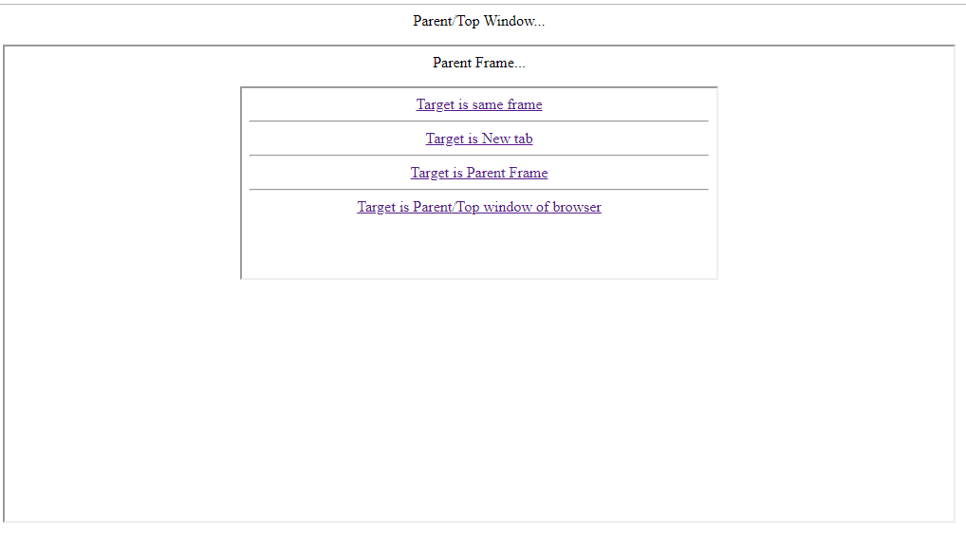
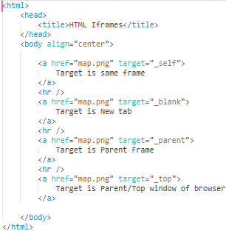
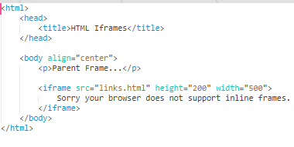
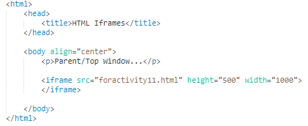

Slide 27
HTML ELEMENTS
<a href=“uri of file to download” download>
Link at bottom of page
</a>

Slide 28
HTML ELEMENTS
<a href=“mailto:nisarsiddiqui.cs@iba-suk.edu.pk” >Email Link</a>

Slide 29
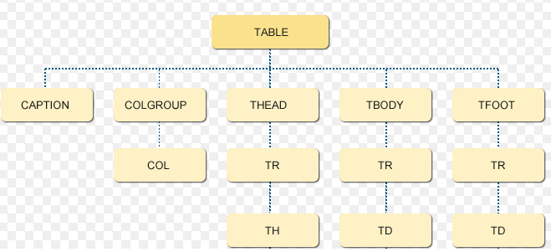
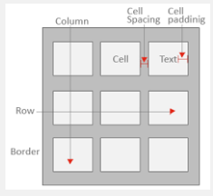
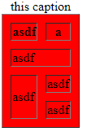
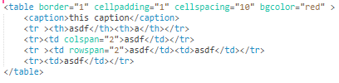
HTML ELEMENTS
Notes:
Attributes of table tag
Border=“value”
Cellpadding=“value”
Cellspacing=“value”
Bgcolor=“color”
Attributes of td tag
Colspan=“number of columns to span the cell”
Rowspan=“number of rows to span the cell”

Slide 30
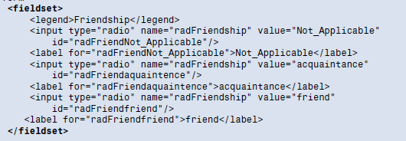

HTML ELEMENTS
<fieldset></fieldset>
Notes:
The fieldset is a useful tool for organizing and grouping related items within a form, and has been used for a long time in desktop applications. When it’s combined
with the legend (which is contained inside the fieldset, and is a required element if you use the fieldset), it has the effect of creating a box around the grouped items and showing a description to the right of each item.

Slide 31
HTML ELEMENTS
<form action=“# or uri” enctype=“multipart/form-data” method=“get/post”>
</form>
Notes:
The HTML <form> element represents a document section that contains interactive controls for submitting information to a web server.
actionThe URI of a program that processes the form information. This value can be overridden by a formaction attribute on a <button>, <input type="submit"> or <input type="image"> element.
Enctype When the value of the method attribute is post, enctype is the MIME type of content that is used to submit the form to the server. Possible values are:
application/x-www-form-urlencoded: It is the default value. It encodes all the characters before sent to the server. It converts spaces into + symbols and special character into its hex value.
multipart/form-data: This value does not encode any character.
text/plain: (HTML5) This value convert spaces into + symbols but special characters are not converted.
This value can be overridden by a form enctype attribute on a <button>, <input type="submit"> or <input type="image"> element.

Slide 32
HTML ELEMENTS
<button name=“hello" type=" { button | reset | submit } “ value="value">
Text to display
</button>
disabled=“disabled”
tabindex=“number”
Accesskey=“k”
After form submission if type is submit only: hello=value of button
Notes:
Attributes
accesskey=“s”
Keyboard combination is different on browsers such as IE/Windows is ALT + key, FireFox/Windows ALT + SHIFT + key and so on
disabled=“disabled”
Stops usage of button
tabindex=“number”
Element with lowest tab index value will get the focus first using tab key
Tab index starts from 0

Slide 33
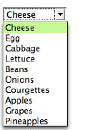

HTML ELEMENTS
<select multiple="multiple" name="string“ size="number“ disabled=“disabled”>
</select>
value=“value”
selected=“selected”
Option tag attributes
After form submission: favoritefood=value of selected item
Notes:
The select form control is a container for a series of option (p. 288) elements that display in the browser as a pull-down menu (that is, a drop-down list).
Unless you use the multiple (p. 299) attribute, the control will allow the user to pick just one item from the list of options that’s generated by the contents of the nested option elements.
Attributes of select tag
multiple=“multiple” : allows multiple selection of items at once
Each option in a select element represents an option that the user can choose. The text contained between the opening <option> and closing </option> tags is
displayed to the user, while the value attribute contains the actual data that will be sent when the form is submitted.
Attributes of option tag
value="value“ : if no value is given default value will be text given for display to the user
selected="selected“ : selected option’s text will be displayed to the user
disabled="disabled“ : stops the user to interact with the option
In case of multiple selection depending on the number of selected items name of list will be repeated for each value such as favoritefood=value1&favoritefood=value2

Slide 34
HTML ELEMENTS
<input type=“hidden” name=“hiddenValue” value=“hiddenText” />
After form submission: hiddenvalue=hiddenText

Slide 35
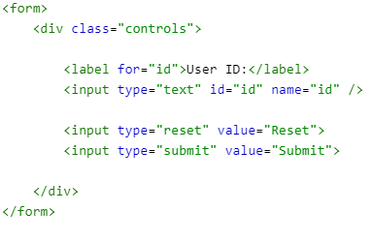
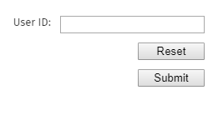
HTML ELEMENTS
After form submission: id=value given by the user&submit=Submit
Notes:
Example of reset button, submit button and text box
Attribute value=“reset” will be default according to type otherwise you can set any value
Attribute disabled standalone or disabled=“disabled” is used for disabling it
In HTML, the `for`, `name`, and `value` attributes serve specific purposes in enhancing form elements and improving accessibility and functionality. Here’s an explanation of each attribute along with real-life examples.
### 1. `for` Attribute
**Usage**: The `for` attribute is used in `<label>` elements to associate the label with a specific form control (like an input field). This improves accessibility and allows users to click the label to focus on the corresponding input.
**Example**:
```html
<form>
<label for="username">Username:</label>
<input type="text" id="username" name="username">
</form>
```
**Explanation**: Clicking on "Username:" will focus the input field associated with the `id="username"`.
---
### 2. `name` Attribute
**Usage**: The `name` attribute is used to identify form elements when submitting form data. It acts as a key in key-value pairs sent to the server, allowing server-side scripts to access the submitted data.
**Example**:
```html
<form action="/submit" method="POST">
<label for="email">Email:</label>
<input type="email" id="email" name="user_email">
<input type="submit" value="Submit">
</form>
```
**Explanation**: When the form is submitted, the data sent to the server will include `user_email` as the key for the email input value, making it easy for the server-side script to process the email address.
---
### 3. `value` Attribute
**Usage**: The `value` attribute specifies the initial value of a form element (like `<input>`, `<button>`, or `<option>`). It can also represent the data that gets sent to the server when the form is submitted.
**Example**:
```html
<form>
<label for="color">Choose a color:</label>
<select id="color" name="favorite_color">
<option value="red">Red</option>
<option value="green">Green</option>
<option value="blue">Blue</option>
</select>
<input type="submit" value="Submit">
</form>
```
**Explanation**: Each option in the dropdown has a `value` attribute. When the user selects a color and submits the form, the selected color will be sent as `favorite_color` with the corresponding `value` of the selected option.
---
### Summary
- **`for` Attribute**: Enhances accessibility by linking labels to inputs, allowing users to click the label to focus on the input.
- **`name` Attribute**: Identifies form elements for data submission, allowing the server to retrieve input values easily.
- **`value` Attribute**: Sets the initial or submitted value of form controls, ensuring the correct data is sent to the server upon submission.

Slide 36
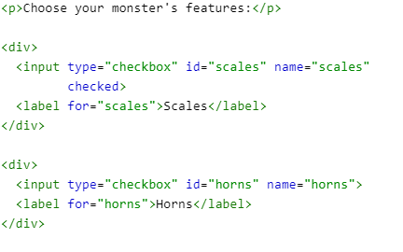
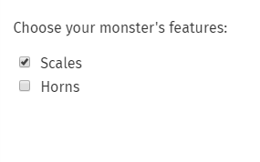
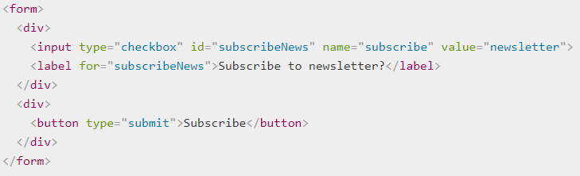

HTML ELEMENTS
After form submission example 1: scales=on
After form submission example 2: subscribe=newsletter
Notes:
Example of checkbox
Attribute value=“any value” can be used for a checkbox to render the value to server side program
In second example, we've got a name of subscribe, and a value of newsletter. When the form is submitted, the data name/value pair will be subscribe=newsletter.
If the value attribute was omitted, the default value for the checkbox is on , so the submitted data in that case would be subscribe=on.

Slide 37
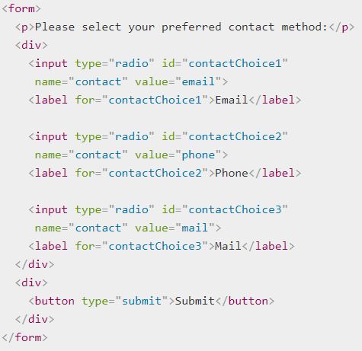

HTML ELEMENTS
After form submission : contact=value of selected radio button
After form submission if no value is specified in selected item: contact=on
Notes:
<input> elements of type radio are generally used in radio groups—collections of radio buttons describing a set of related options. Only one radio button in a given group can be selected at the same time. Radio buttons are typically rendered as small circles, which are filled or highlighted when selected.
A radio group is defined by giving each of radio buttons in the group the same name. Once a radio group is established, selecting any radio button in that group automatically deselects any currently-selected radio button in the same group. You can have as many radio groups on a page as you like, as long as each has its own unique name.
When the above form is submitted with a radio button selected, the form's data includes an entry in the form contact=value. For example, if the user clicks on the "Phone" radio button then submits the form, the form's data will include the line contact=phone.
To make a radio button selected by default, you simply include checked attribute.
If you omit the value attribute in the HTML, the submitted form data assigns the value on to the group. In this scenario, if the user clicked on the "Phone" option and submitted the form, the resulting form data would be contact=on, which isn't helpful. So don't forget to set your value attributes!

Slide 38
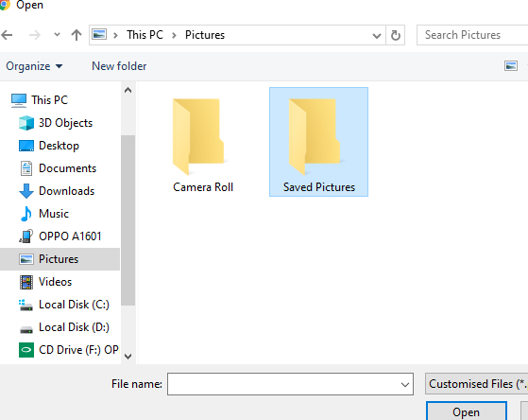
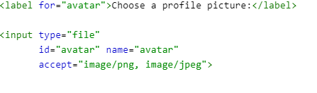
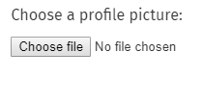
HTML ELEMENTS
multiple=“multiple”
required=“required”
After form submission: ?avatar=nameOfChosenFile
After form submission: ?avatar=nameOfChosenFile1&avatar=nameOfChosenFile2
Notes:
<input> element with type="file" let the user choose one or more files from their device storage. Once chosen, the files can be uploaded to a server using form submission, or manipulated using JavaScript code and the File API.
A file input's value attribute contains a DOMString that represents the path to the selected file(s). If the user selected multiple files, the value represents the first file in the list of files they selected.
A accept string defines the file types the file input should accept. This string is a comma-separated list of unique file type specifiers. Because a given file type may be identified in more than one manner, it's useful to provide a thorough set of type specifiers when you need files of a given format.
When the multiple Boolean attribute is specified, the file input allows the user to select more than one file.
Regardless of the user's device or operating system, the file input provides a button that opens up a file picker dialog box that allows the user to choose a file and multiple files can be chosen if multiple attribute is set then when the form is submitted, each selected file's name will be added to URL parameters in the following fashion: ?file=file1.txt&file=file2.txt, note file is the name of file control.

Slide 39
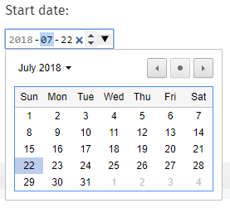
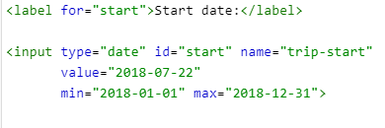
HTML ELEMENTS
required=“required”
After form submission: ?trip-start=date selected
Notes:
<input> element of type date create input field that let the user enter a date, either using a text box that automatically validates the content, or using a special date picker interface. The resulting value includes the year, month, and day, but not the time.
The control's UI varies in general from browser to browser.
The latest date to accept. If the value entered into the element is later than this date, the element fails constraint validation. If the value of the max attribute isn't a valid string which follows the format yyyy-MM-dd, then the element has no maximum value.
The earliest date to accept; dates earlier than this will cause the element to fail constraint validation. If the value of the min attribute isn't a valid string which follows the format yyyy-MM-dd, then the element has no minimum value.
you can use the required attribute to make filling in the date mandatory and an error will be displayed if you try to submit an empty date field.

Slide 40
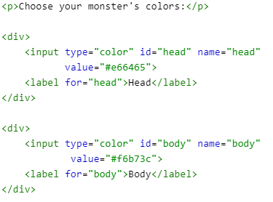
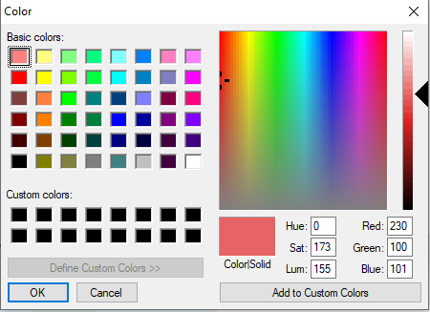
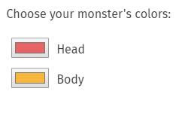
HTML ELEMENTS
After form submission: ?head=hex-code-of-color&body=hex-code-of-color
Notes:
<input> element of type color provide a user interface element that lets a user specify a color, either by using a visual color picker interface or by entering the color into a text field in #rrggbb hexadecimal format.
The element's presentation may vary substantially from one browser and/or platform to another.
The value of an <input> element of type color is always a DOMString which contains a 7-character string specifying an RGB color in hexadecimal format. While you can input the color in either upper or lower-case, it will be stored in lower-case form. The value is never in any other form, and is never empty.
You can update the simple example above to set a default value, so that the color well is pre-filled with the default color and the color picker (if any) will also default to that color.
If you don't specify a value, the default is #000000, which is black.
The value must be in seven-character hexadecimal notation, meaning the "#" character followed by two digits each representing red, green, and blue, like this: #rrggbb.

Slide 41
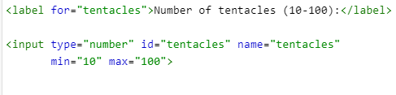
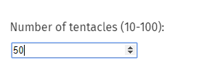
HTML ELEMENTS
readonly=“readonly”
required=“required”
placeholder=“value”
value=“default”
step=“interval”
After form submission: ?tentacles=selected number
Notes:
<input> element of type number is used to lets the user enter a number. They include built-in validation to reject non-numerical entries. The browser may opt to provide stepper arrows to let the user increase and decrease the value using their mouse or by simply tapping with a fingertip.
Attribute value: a Number representing the value of the number entered into the input. You can set a default value for the input by including a number inside the value attribute, like so value=“10”;
Attribute max The maximum value to accept for this input
Attribute minThe minimum value to accept for this input
Attribute placeholder An example value to display inside the field when it's empty
Attribute readonly A Boolean attribute controlling whether or not the value is read-only
Attribute step A stepping interval to use when using up and down arrows to adjust the value, as well as for validation
Attributes readonly and required can’t be used at the same time
One can type lesser value than minimum into the input field but can not submit it and same is valid for the maximum value

Slide 42
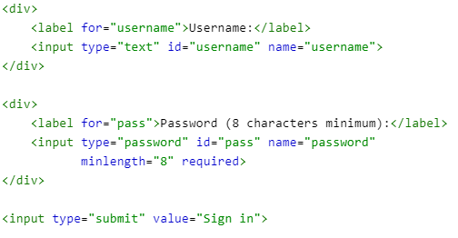
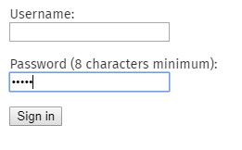
HTML ELEMENTS
readonly=“readonly”
required=“required”
placeholder=“value”
value=“default”
size=“no# of characters wide”
maxlength=“no# of characters”
Notes:
<input> elements of type password provide a way for the user to securely enter a password. The element is presented as a one-line plain text editor control in which the text is obscured so that it cannot be read, usually by replacing each character with a symbol such as the asterisk ("*") or a dot ("•"). This character will vary depending on the user agent and OS.
Attributes
value to set default text in the field and to get the text of the field
Maxlength The maximum length the value may be, in UTF-16 characters
Minlength The minimum length in characters that will be considered valid
Pattern A regular expression the value must match in order to be valid
Placeholder An example value to display in the field when the field is empty
Readonly A Boolean attribute which, if present, indicates that the field's contents should not be editable
Size The number of characters wide the input field should be
required to set the field value is required

Slide 43
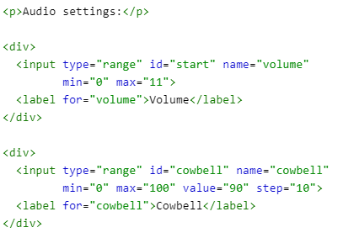
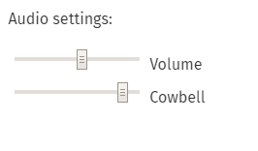
HTML ELEMENTS
step=“interval for increasing the value ”
Notes:
<input> elements of type range let the user specify a numeric value which must be no less than a given value, and no more than another given value.
The precise value, however, is not considered important. This is typically represented using a slider or dial control rather than a text entry box like the number input type. Because this kind of widget is imprecise, it shouldn't typically be used unless the control's exact value isn't important.
If the user's browser doesn't support type range, it will fall back and treat it as a text input.
A few examples of situations in which range inputs are commonly used:
Audio controls such as volume and balance, or filter controls.
Color configuration controls such as color channels, transparency, brightness, etc.
Game configuration controls such as difficulty, visibility distance, world size, and so forth.
Password length for a password manager's generated passwords.
Attributes
Value to set default and get the value selected
Max The maximum permitted value
Min The minimum permitted value
Step The stepping interval, used both for user interface and validation purposes
By default stepper will be at the center value but can be changed by defining the value in value attribute

Slide 44
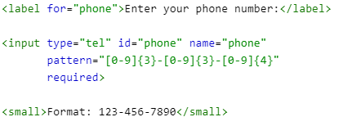
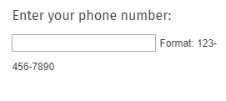
HTML ELEMENTS
placeholder=“value”
value=“default”
required=“required”
Notes:
<input> elements of type tel are used to let the user enter and edit a telephone number. Unlike <input type="email"> and <input type="url"> , the input value is not automatically validated to a particular format before the form can be submitted, because formats for telephone numbers vary so much around the world.
Attributes
Value to set and get the value
Pattern A regular expression the entered value must match to pass constraint validation
Placeholder An example value to display inside the field when it has no value

Slide 45
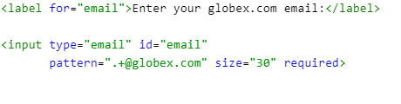
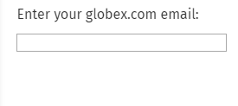
HTML ELEMENTS
placeholder=“value”
value=“default”
required=“required”
multiple=“multiple”
Notes:
<input> element of type email is used to let the user enter and edit an e-mail address.
The multiple attribute is specified, a list of e-mail addresses can be passed that would be comma separated and in a query string after form submission comma separated list of email ids will be passed.
The input value is automatically validated to ensure that it's either empty or a properly-formatted e-mail address (or list of addresses) before the form can be submitted.
If no pattern is placed then standard pattern used for email addresses will be used.
The maximum number of characters (as UTF-16 code units) the user can enter into the email input. This must be an integer value 0 or higher. If no maxlength is specified, or an invalid value is specified, the email input has no maximum length. This value must also be greater than or equal to the value of minlength.
The minimum number of characters (as UTF-16 code units) the user can enter into the email input. This must be an non-negative integer value smaller than or equal to the value specified by maxlength. If no minlength is specified, or an invalid value is specified, the email input has no minimum length.
Readonly A Boolean attribute indicating whether or not the contents of the input should be read-only

Slide 46
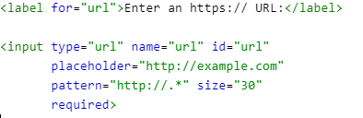
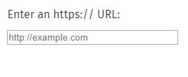
HTML ELEMENTS
value=“default”
required=“required”
multiple=“multiple”
Notes:
<input> element of type url is used to let the user enter and edit a URL.
The input value is automatically validated to ensure that it's either empty or a properly-formatted URL before the form can be submitted.
On browsers that don't support inputs of type url, a url input falls back to being a standard text input.
Maxlength The maximum number of characters the input should accept
Minlength The minimum number of characters long the input can be and still be considered valid
Readonly A Boolean attribute indicating whether or not the contents of the input should be read-only

Slide 47
HTML ELEMENTS: Common Attributes: Core Attributes
class=“class-name”
Notes:
This attribute takes as its value a space-delimited list of one or more class names.
If there are more than one class names then style of all classes will be applied on the element if rules for all classes are present otherwise style of only those classes will be applied whose rules are present.

Slide 48
HTML ELEMENTS: Common Attributes: Core Attributes
id=“identifier”
Notes:
The id attribute provides a unique identifier for an element within the document.
This identifier may also be used in CSS code as a hook that can be used for styling purposes, or by JavaScript code (via the Document Object Model, or DOM) to make changes or add behavior to the element by referencing its unique id.

Slide 49
HTML ELEMENTS: Common Attributes: Core Attributes
style=“color:blue; font-style:italic;”
Notes:
Style attribute is used to apply inline css for the targeted element only and may be inherited by the children of the element

Slide 50
HTML ELEMENTS: Common Attributes: Core Attributes
title=“this is the tool tip text”
Notes:
The title attribute allows the author to provide extra information about any element on a page. Typically, this attribute’s content is rendered as a tooltip that appears when the user hovers the cursor over the element to which the title is applied.

Slide 51
HTML ELEMENTS: Common Attributes: event attributes
onfocus=“javascript”
Notes:
The onfocus attribute captures the moment when an element receives the focus of the user’s attention.
This is determined to be the point at which a user clicks inside an element that can be activated or manipulated, such as a form input.
Typically, this attribute is used to highlight the section of the page that currently has focus—a useful usability enhancement, particularly for people with low vision—or to provide additional information. For example, when a user’s completing a form, additional help text can be made to appear alongside the form input that currently has focus.

Slide 52
HTML ELEMENTS: Common Attributes: event attributes
onblur=“javascript”
Notes:
onblur is the opposite of the onfocus attribute
This will call the code when an element loses the focus because the user has used the tab key to move to the
next element on the page, or has placed the cursor in another section of the page.
onblur is most often used with form validation code. When the user leaves a form field, the onblur attribute is used to call a piece of script that performs some sort
of validation on the field to make sure that the correct data was entered, rather than leaving all the validation to execute at the form’s end.

Slide 53
HTML ELEMENTS: Common Attributes: event attributes
onchange=“javascript”
<input type=“text” onchange=“call();” />
<textarea onchnage=“call();”></textarea>
<select onchange=“call();”>
<option>value 1</option>
<option>value 2 </option
</select>
Notes:
It can be applied to an input, a textarea, or a select control to identify when the value of one of those elements is changed either by the user directly, or
as a result of some scripting on the page.

Slide 54
HTML ELEMENTS: Common Attributes: event attributes
onclick=“javascript”
<input type=“checkbox” onclick=“call();” />
<input type=“radio” onclick=“call();” />
<input type=“button” onclick=“call();” />
Notes:
The onclick event handler captures a click event from the users’ mouse button on the element to which the onclick attribute is applied.
This action usually results in a call to a script method such as a JavaScript function.
There can be multiple functions called on click of an element e.g. onclick="doThisFunction();thenDoTheOtherFunction();“
Further onchange attribute is also used to trigger the event on changing the state of checkbox and radio button.

Slide 55
HTML ELEMENTS: Common Attributes: event attributes
ondblclick=“javascript”
Notes:
The ondblclick event handler captures a double-click event from the user’s mouse button on the element to which the ondblclick attribute is applied.
This will usually result in a call to a script method such as a JavaScript function.
Note that the onclick event handler will fire before the ondblclick event handler.
Example is: ondblclick="doMyFunction();"

Slide 56
HTML ELEMENTS: Common Attributes: event attributes
onkeydown=“javascript”
Notes:
The onkeydown event handler captures the moment that a key is pressed down but has not yet been released.

Slide 57
HTML ELEMENTS: Common Attributes: event attributes
onkeyup=“javascript”
Notes:
After key down and press when key has been released key up event triggers

Slide 58
HTML ELEMENTS: Common Attributes: event attributes
onmouseover=“javascript”
Notes:
The onmouseover attribute is one of the most commonly used event attributes. It captures the moment that a cursor crosses the boundary of an element, moving from
outside to inside the element to which the attribute is applied. It differs from the onmousemove attribute, which is used to detect movement within the element’s
boundaries. Once the cursor is positioned over the element, the onmouseover event remains active until the cursor is moved beyond the element’s boundaries—an event
that the onmouseout attribute would capture.

Slide 59
HTML ELEMENTS: Common Attributes: event attributes
onmouseout=“javascript”
Notes:
The onmouseout attribute is the “partner” attribute to the commonly used onmouseover attribute. It captures the moment that a mouse pointer crosses
the boundary of an element, moving from the inside to the outside of the element to which the attribute is applied.
onmouseout is mostly used for resetting a visual effect that was previously applied by the onmouseover attribute—for example, reinstating the default state of an image
that was swapped for a new image.

Slide 60
HTML ELEMENTS: Common Attributes: event attributes
onmousemove=“javascript”
Notes:
The onmousemove event handler is used to identify any movement of the mouse in any direction within the boundaries of an element, irrespective of any mouse button actions.

Slide 61
HTML ELEMENTS: Common Attributes: event attributes
onmousedown=“javascript”
Notes:
The onmousedown attribute is similar to the onclick attribute, but differs in that the event is triggered the moment the mouse button is pressed on the element, rather
than at the point at which the mouse button is released (onclick is effectively a combination of onmousedown and onmouseup event on the element in question).
This event isn’t often seen in practice, possibly because it can so easily cause events to be triggered accidentally. If you’re using an onclick event, the user can move the
cursor off the element, release the mouse button, and avoid triggering the action if it was an accidental button press; this is not the case with onmousedown.

Slide 62
HTML ELEMENTS: Common Attributes: event attributes
onmouseup=“javascript”
Notes:
The onmouseup attribute is the counterpart to the onmousedown attribute. It triggers an event when the user releases the mouse button while the cursor is positioned
over the element to which the attribute is applied. Just as onmousedown is not greatly used, its partner onmouseup isn’t common.

Slide 63
HTML ELEMENTS: Common Attributes: event attributes
onselect=“javascript”
Notes:
The onselect attribute is used in forms, specifically on the text input and textarea form controls. When the user selects any text inside these elements,
either by clicking and dragging the cursor, or using keyboard text selection commands (such as pressing Shift + Right arrow key), the onselect attribute captures
this event.

Slide 64
HTML ELEMENTS: Common Attributes: event attributes
onreset=“javascript”
Notes:
The onreset attribute is used only within the context of forms, and is applied directly to the form element.
When the user activates the form’s Reset button (if indeed it has one), the event is captured by this attribute, and can be used for whatever purpose the developer chooses.
Note that this attribute is used less commonly these days. Reset buttons on forms themselves have become increasingly rare, since they make it all too easy to accidentally wipe out all the details the user has spent time entering.

Slide 65
HTML ELEMENTS: Common Attributes: event attributes
onsubmit=“javascript”
Notes:
The onsubmit attribute is used on the form element only. Its purpose is to capture the moment when the form is submitted, following the moment when the
user activates the form’s Submit button.

Slide 66
HTML ELEMENTS: Common Attributes: event attributes
onload=“javascript”
Notes:
The onload event occurs when an object has been loaded.
The onload event is used to trigger an action once a web page has completely loaded all content and, importantly, all of the external resources that the page calls in.
It may also be used in the context of framesets to indicate that the child frame elements have finished loading.
Mainly this event is triggered by the developers on the body element.

